Slide 1
Object Oriented Programming (Introduction to Programming) Manuel Mazzara
Organizational Information

Slide 2
Mid-term Exam
7.10.2015

Slide 3
Textbook
Bertrand Meyer: Touch of Class, Learning to Program Well with Objects and Contracts, Springer 2009, ISBN: 978-3-540-92144-8

Slide 4
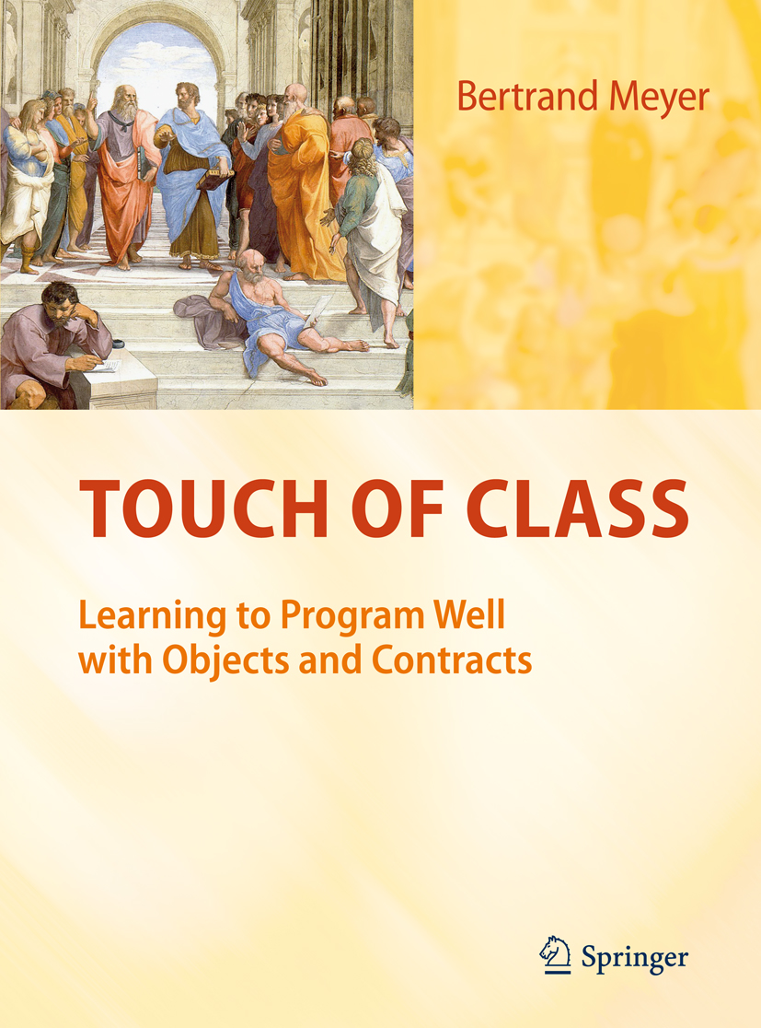


Slide 5
Survey
http://goo.gl/forms/HMw586zG9q
It helps us to understand your level of acquitance with computers and computer science
We will tune lectures and labs accordingly
Next year a different division of groups may be implemented
Your TA will repeat and explain this later today

Slide 6
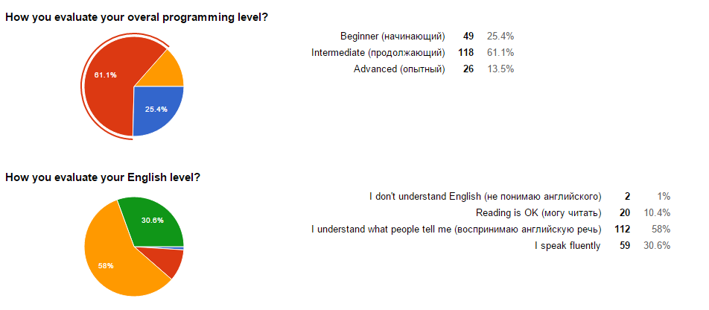
Results of the Survey
https://docs.google.com/forms/d/1G7lQgg_NsnjPWXh_r0NMMecZkFJKhHgoPqhDprNIl3M/viewanalytics
193 answers so far

Slide 7
We teach principles and concepts
… not technology!
Do not be afraid of the specific technologies we take as examples
You will learn more and more languages and technologies in your life
Focus on the concepts and this will stay with you for all your professional life!

Slide 8
Object Oriented Programming (Introduction to Programming) Manuel Mazzara
Lecture 5: Control Structures

Slide 9
Reading Assignment
For the next three lectures we will mostly cover chapter 5 and 7 of the textbook
Please have a look at the slides afterwards, not always we have time to cover all the material
Independent study is necessary and is accounted for at least 50% of you effort

Slide 10
In this lecture
The notion of algorithm
Basic control structures: sequence, conditional, loop
Decision structures: variants of conditional instruction
Repeating operations: the loop
Loops as approximation strategy: the loop invariant
What does it take to ensure that a loop terminates?
A look at the general problem of loop termination
Lower-level control structures: “Goto” and flowcharts; see rationale for the “control structures of Structured Programming”
Notes:
In order to run a program we need two things, 1) Actions and 2) controls enabling to structure the sequence of actions (compounds [or sequence], conditionals, and loops)
https://www.youtube.com/watch?v=yC9SQJnTvo4
Computer science is about algorithms and data

Slide 11
The notion of algorithm
General definition:
An algorithm is the specification of a (computational) process to be carried out by a computer
Sum of two integer numbers

Slide 12
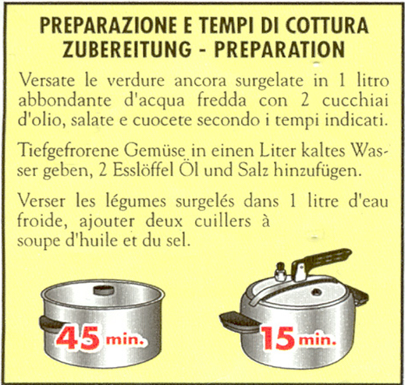
Not quite an algorithm
Pour the still frozen vegetables in one liter of cold water, add two tablespoons of oil and salt
Notes:
The Italian version is more similar to an algorithm than the other two…
So here we have a recipe, but not an algorithm

Slide 13
Properties of an algorithm
Defines the data on which the algorithm will be applied (data and algorithm go side by side in computer science)
Every elementary step taken from a set of well-specified actions
Describes ordering(s) of execution of these steps
Properties 2 and 3 based on precisely defined conventions, suitable for an automatic device
For any data, guaranteed to terminate after finite number of steps (Not everybody agrees on the 5th property)
Notes:
Not everybody agrees on the 5th property.
Prop. 1: data and algorithm go side by side in computer science

Slide 14
Algorithm vs program
“Algorithm” usually considered a more abstract notion, independent of platform, programming language etc.
In practice, the distinction tends to fade:
Algorithms need a precise notation
Programming languages becoming more abstract
However:
In programs, data (objects) are just as important as algorithms
A program typically contains many algorithms and object structures
Program = algorithm(s) + data structure(s)
Notes:
The difference is often one of “spirit”. However
Algorithms need a precise notation: see property 4 of previous slide

Slide 15
What makes up an algorithm
Basic steps:
Feature call x.f (a )
Assignment
...
Sequencing of these basic steps: CONTROL STRUCTURES
(Actually, not much else!)
Notes:
Assignment x := y

Slide 16
Control structures
Definition: program construct that describes the scheduling of basic actions
Three fundamental control structures:
Sequence
Loop
Conditional
They are the
“Control structures of Structured Programming”

Slide 17
Control structures as problem-solving techniques
Sequence: “To achieve C from A, first achieve an intermediate goal B from A, then achieve C from B”
Loop: solve the problem on successive approximations of its input set
Conditional: solve the problem separately on two or more subsets of its input set
Notes:
Sequence - compare it to declarative languages such as SQL

Slide 18
The sequence (or Compound)
instruction ₁
instruction ₂
...
instruction _{n}

Slide 19
Semicolon as optional separator
instruction₁ ;
instruction₂ ;
... ;
instruction_{n}

Slide 20
Correctness of a Compound
Precondition of instruction ₁ must hold initially
Postcondition of each instruction _{i} must imply precondition of each instruction _{i + 1}
Final effect is postcondition of instruction _{n}
{P₁}
instruction ₁
instruction ₂
...
instruction _{i}
...
instruction _{n}
{Q₁}
{P₂}
{Q₂}
{P_{i} }
{Q_{i} }
implies
{P_{n} }
{Q_{n} }

Slide 21
Conditional instruction
if
Condition
then
Instructions
else
Other_instructions
end
-- Boolean_expression
-- Compound
-- Compound
Notes:
The conditional allows us to decide at runtime which path to take, based on same condition

Slide 22
Computing the greater of two numbers
if
a > b
then
max := a
else
max := b
end

Slide 23
As a query
maximum (a, b : INTEGER): INTEGER
-- The larger value between a and b.
do
if
a > b
then
Result := a
else
Result := b
end
end

Slide 24
Example
i, j, k, m, n : INTEGER
…
m := maximum (25, 32)
n := maximum (i + j, k)

Slide 25
The conditional as problem-solving technique
PROBLEM SPACE
Region 2
Use technique 2
Region 1
Use technique 1

Slide 26
Basic form
if Condition then
Instructions
else
Other_instructions
end

Slide 27
A variant of the conditional
if Condition then
Instructions
end
Means the same as
if Condition then
Instructions
else
end
Empty clause

Slide 28
Example of a then without else clause
if date > due_date then
penalty := …
amount := amount + penalty
end

Slide 29
Nesting
if Condition₁ then
Instructions ₁
else
end
if Condition₂ then
Instructions ₂
else
end
if Condition₃ then
Instructions ₃
else
end
if Condition₃ then
Instructions ₄
else
end
...

Slide 30

Nested structure

Slide 31

Comb-like structure

Slide 32
Comb-like conditional
if Condition₁ then
Instructions ₁
elseif Condition ₂ then
Instructions ₂
elseif Condition₃ then
Instructions ₃
elseif
...
else
Instructions ₀
end
Notes:
elsif is the ONLY keyword (out of 64 or so) composed of two english words

Slide 33
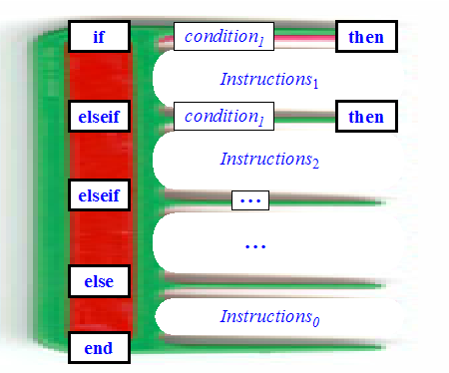
Comb-like structure

Slide 34
The most general form
if Condition₁ then
Instructions ₁
elseif Condition ₂ then
Instructions ₂
elseif Condition₃ then
Instructions ₃
elseif
...
else
Instructions ₀
end
Always one
Zero or more
Zero or one

Slide 35
More control structure topics
Loops and their invariants
See what it takes to ensure that a loop terminates
Look at the general problem of loop termination (not in this course, details in TOC)
Examine lower-level control structures: “Goto” and flowcharts; see rationale for the “control structures of Structured Programming”

Slide 36
Loop
from
Initialization -- Compound
variant
Variant_expression -- Integer expression
invariant
Invariant_expression -- Condition
until
Exit_condition -- Boolean_expression
loop
Body -- Compound. Executed until Exit_condition is false
end
Notes:
The exit condition works the opposite way of Java/C!!!
The compound of the initialization can be empty
How do we know that the loop will terminate? In general, we don’t!!!

Slide 37
Loop: example
from
i := 1
until
i > n
loop
sum := sum + i
i := i + 1
end

Slide 38
Loop, full form
from
Initialization -- Compound
invariant
Invariant_expression -- Boolean_expression
variant
Variant_expression -- Integer_expression
until
Exit_condition -- Boolean_expression
loop
Body -- Compound
end
Notes:
Invariant: a property which will be true after initialization and preserved after every iteration of the body
Variant: will help us determine that the loop terminates
These two components are optional

Slide 39
What is that?
Invariant and Variant are optional
Invariant: a property which will be true after initialization and preserved after every iteration of the body
Variant: will help us determine that the loop terminates

Slide 40
Loop, full form: example
loop_example
-- A loop example...
local
count: INTEGER
do
from
count := 1
invariant
count >= 1
count <= 101
variant
101 - count
until
count > 100
loop
io.put_integer (count)
io.put_new_line
count := count + 1
end
end
Notes:
http://se.inf.ethz.ch/old/teaching/ws2006/0001/exercises/assignment_5.pdf

Slide 41
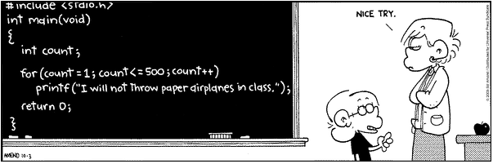
Another loop syntax

Slide 42
Loops in different languages
from -- Eiffel
Initialization
until
Condition
loop
Body
end
while Condition do
Body end
repeat
Body until Condition end
across -- Eiffel
data_structure as var
loop
Body -- Using var
end
for i : a..b do Body
for (Initialization; Condition; Advance) do Body
end
Notes:
nicht unbedingt

Slide 43
Loop, full form
from
Initialization -- Compound
invariant
Invariant_expression -- Boolean_expression
variant
Variant_expression -- Integer_expression
until
Exit_condition -- Boolean_expression
loop
Body -- Compound
end

Slide 44
The loop invariant
.
The desired solution(s)
The exit condition
The body
The invariant
The previous state
The body
The initialization
Notes:
Solution = intersection between the invariant and some condition (the exit condition)

Slide 45
The solution
The solution is the intersection between the invariant and some condition (the exit condition)

Slide 46
Loop invariant
(Do not confuse with class invariant)
Property that is:
Satisfied after initialization (from clause)
Preserved by every loop iteration (loop clause) executed with the exit condition (until clause) not satisfied
Notes:
http://sel.ifmo.ru/seminar/invariants.pdf

Slide 47
Loop invariants - Summary
A loop is characterized by an invariant
The invariant is key to establishing the loop’s correctness
The invariant holds initially, and is preserved by every iteration, so it holds on exit
On exit, the exit condition also holds; the conjunction of the invariant and exit condition gives us the effect of the loop
Now for the bad news: if you want to be sure of your program’s correctness, you have to find the invariant!

Slide 48
Loop, full form
from
Initialization -- Compound
invariant
Invariant_expression -- Boolean_expression
variant
Variant_expression -- Integer_expression
until
Exit_condition -- Boolean_expression
loop
Body -- Compound
end
Notes:
The variant expression is a non negative integer!

Slide 49
Computing a sum of numbers
from
Result := 0
i := 0
until
i >= n
loop
i := i + 1
Result := Result + i
end
∑ i
n
i = 1
Notes:
Exit condition should be i >= n
Correct invariant: i <= n; i>= 0; REsult = sum j (j= 1..i)

Slide 50
Loop variant
Integer expression that must:
Be non-negative when after initialization (from)
Decrease (i.e. by at least one), while remaining non-negative, for every iteration of the body (loop) executed with exit condition not satisfied

Slide 51
Computing a sum of numbers
from
Result := 0
i := 0
until
i >= n
loop
i := i + 1
Result := Result + i
end
∑ i
n
i = 1
What are the loop variant/invariant?
Notes:
Exit condition should be i >= n
Correct invariant: i <= n; i>= 0; REsult = sum j (j= 1..i)
The loop variant is n - i + 1

Slide 52
What is the loop variant?
The loop variant is
n - i + 1

Slide 53
What is the loop invariant?
Exit condition is i >= n
i <= n; i>= 0; Result = sum j (j= 1..i)

Slide 54
Loop variant - Summary
Programs run the risk of not terminating
There is no general rule to find out whether an arbitrary program will terminate (Halting problem, you will study in detail next semester in TOC )
… but yours have to, so make sure you know the variant of every loop!

Slide 55
One-entry, one-exit
(Compound)
(Loop)
(Conditional)

Slide 56
What we have seen
The notion of algorithm Basic properties Difference with “program” The notion of control structure Correctness of an instruction Control structure: sequence Control structure: conditional Nesting, and how to avoid it Correctness of loops: invariants and variants

